Slide 1
Relationship Between Basic Skills Success and Performance in Transfer Level Courses
Preliminary Results
(May 25, 2010)
Gregory M. Stoup
Director of Planning & Research
Cañada College

Slide 2
Research Framework
Objective: Examine the performance of students in transfer level courses broken out by degree of basic skills remediation.
Approach: Select a set of introductory transfer level courses having sufficient sample sizes of students in each basic skills category examined over the study period (2000/01 – 2008/09).
Research Goal: Determine if performance in the transfer course cohort is a function of the placement level of basic skills remediation.

Slide 3
Methodology
Pulled the placement records of all students taking the placements test over the period Fall 2000 – Spring 2009.
Identified all introductory transfer level courses taken by these students after taking their placement test (no retakes included)
Determined the level of basic skill remediation for each student at the time of enrollment in each introductory transfer level course
Calculated the performance of students in these transfer courses segmented by their degree of basic skills remediation
Made adjustments to isolate the relationship between a specific basic skill domain (Reading, English or Math) and performance in transfer course.

Slide 4
Courses in the Selection Pool
 | Recommended Eligibilty
Transfer Level Introductory Course | Reading | English | Math | Transferability
General Psychology (PSYC 100) | Read 836 | Engl 836 |  | IGETC
Intro to Sociology (SOCI 100) | Read 836 | Engl 836 |  | IGETC
Principles of Macro Economics (ECON 100) | Read 836 | Engl 836 |  | IGETC
Principles of Micro Economics (ECON 102) | Read 836 | Engl 836 |  | IGETC
History of Western Civilization I (HIST 100) | Read 836 | Engl 836 |  | IGETC
Cultural Anthropology (ANTH 110) | Read 836 | Engl 836 |  | IGETC
Art of the Western World (ART 100) | Read 836 | Engl 836 |  | CSU
Survey of Business (BUS 100) | Read 836 | Engl 836 |  | CSU; UC
Intro to Astronomy (ASTR 100) | Read 836 | Engl 836 | Math 110 | IGETC
Principles of Biology (BIO 110) | Read 836 | Engl 836 |  | IGETC
Intro to Philosophy (PHIL 100) |  | Engl 100 |  | IGETC
Intro to Interior Design (INTD 115) | Read 836 | Engl 836 |  | CSU
American Politics (PLSC 210) | Read 836 | Engl 836 |  | IGETC
Beginning Clothing Construction (FASH 110) | Read 836 | Engl 836 |  | CSU

Slide 5
Placement patterns have remained fairly stable over the decade.
Placement of Canada Students
Group Placement | 2000/01 | 2004/05 | 2008/09
MATH
Pre-Algebra | 37.8% | 36.1% | 41.5%
Elem Algebra | 37.1% | 34.3% | 32.1%
Intermediate Algebra | 14.6% | 15.9% | 13.9%
Transfer Level Math | 10.5% | 13.7% | 12.6%
READING
Developmental Reading | 49.1% | 45.4% | 47.5%
Acad Reading Strategies | 25.2% | 28.4% | 29.2%
No Reading Required | 25.7% | 26.1% | 23.3%
ENGLISH
Basic Composition | 49.7% | 48.2% | 48.3%
Writing Development | 31.7% | 32.1% | 32.8%
Transfer Level English | 18.5% | 19.8% | 19.0%

Slide 6
Basic Skills Math Sequence

Slide 7
Profile of our Mathematics Course Sequence
Algebra Curriculum Sequence
PRE ALGEBRA
ELEMENTARY ALGEBRA
INTERMEDIATE ALGEBRA
TRANSFER LEVEL MATH
Course Pass % = 55%
Course Pass % = 50%
Course Pass % = 55%
Course Pass % = 75%
Placement Patterns
(2006/07 – 2008/09)

Slide 8
Performance in Transfer Courses based on the degree of Math remediation
Average College Success Rate in Transfer Courses = 75.2%

Slide 9
Sequence Completion Rates by Initial Course Placement
Basic Skills Curriculum Sequence
PRE ALGEBRA
ELEMENTARY ALGEBRA
INTERMEDIATE ALGEBRA
TRANSFER LEVEL MATH
Course Pass % = 55%
Course Pass % = 50%
Course Pass % = 55%
Course Pass % = 75%
Percent of Students Completing the Algebra Sequence within 2 to 5 Years
Initial Placement
2 years
2.3%
15.5%
43.4%
3 years
3.6%
19.1%
47.6%
4 years
5.4%
20.6%
49.2%
5 years
6.1%
22.4%
49.2%
PRE ALGEBRA
ELEMENTARY ALGEBRA
INTERMEDIATE ALGEBRA

Slide 10
Basic Skills Reading & English Sequences

Slide 11
Profile of Developmental English & Reading
Basic Composition
Writing Development
TRANSFER LEVEL ENGLISH
Course Pass % = 58%
Course Pass % = 64%
Developmental Reading
Reading Strategies
Course Pass % = 58%
Course Pass % = 67%
Course Pass % = 69%
Placement Patterns
(2006/07 – 2008/09)
English
Reading

Slide 12
Performance in Transfer Courses based on the degree of Reading remediation
Average College Success Rate in Transfer Courses = 75.2%

Slide 13
Performance in Transfer Courses based on the degree of English remediation
Average College Success Rate in Transfer Courses = 75.2%

Slide 14
Profile of Developmental English & Reading
Basic Composition
Writing Development
TRANSFER LEVEL ENGLISH
Course Pass % = 58%
Course Pass % = 64%
Developmental Reading
Reading Strategies
Course Pass % = 58%
Course Pass % = 67%
Course Pass % = 69%
Percent of Students Completing the Basic Skills Sequence within 2 to 5 Years
Initial Placement
2 years
20.3%
22.1%
3 years
23.9%
24.8%
4 years
27.2%
29.9%
5 years
27.7%
30.1%
ENGL 826
READ 826

Slide 15
Performance in Transfer Level Course as a function of degree of remediation in Math and Reading

Slide 16
Success rates of students in select transfer level courses
(Summer 2000 – Spring 2009)
Placed into Pre-Algebra & Did Not Pass the Course
Placed into Transfer Level math or Completed the BS Algebra Sequence
+ 35.9%
+ 46.2%
N = 182
N = 149
+ 37.1%
+ 36.9%
N = 216
N = 151

Slide 17
Success rates of students in select transfer level courses
(Summer 2000 – Spring 2009)
Placed into Reading 826 & Did Not Pass the Course
Placed into Transfer Level Reading or Completed the Basic Skills Reading Sequence
+ 22.2%
+ 27.0%
N = 315
N = 281
+ 14.8%
+ 25.8%
N = 88
N = 184

Slide 18
Now for the kicker!
Just when you thought you had it all figured out…

Slide 19
Question to consider: what are the most valuable skills being developed in our remedial programs?
Success rates of students taking Yoga
(Summer 2000 – Spring 2009)
Placed into Pre-Algebra & Did Not Pass the Course
Placed into Reading 826 & Did Not Pass the Course
Placed into Transfer Level math or Completed the BS Algebra Sequence
Placed into Transfer Level Reading or Completed the Basic Skills Reading Sequence
+ 25.1%
+ 19.8%
N = 115
N = 121

Slide 20
At this risk of overloading you with information…

Slide 21
We’ve just looked at student achievement as defined by success rates
Recall the evidence we collected that indicated a Mastery Effect in basic skill sequence completion

Slide 22
Sequence Completion Rates by Initial Course Placement
Cañada Curriculum Sequence
PRE ALGEBRA
ELEMENTARY ALGEBRA
INTERMEDIATE ALGEBRA
TRANSFER LEVEL MATH
Percent of Students Successfully Completing the Algebra Sequence within 2 to 5 Years
Initial Placement
2 years
8.8%
0.8%
3 years
13.8%
1.7%
4 years
15.3%
2.5%
5 years
17.8%
2.5%
Mastery is key! Preliminary findings suggest that students receiving an A grade in Pre-Algebra are 8 or 9 times more likely to complete the algebra sequence.
Received an “A” in Pre-Algebra*
Did not Receive an “A” in Pre-Algebra
Important Finding: For students receiving an A in Pre-Algebra there is no disproportional impact by ethnicity in algebra sequence completion.
* Math 811 is a self-paced course. Cohort is restricted students receiving an A grade and completing the course in one semester (3.0 units).

Slide 23
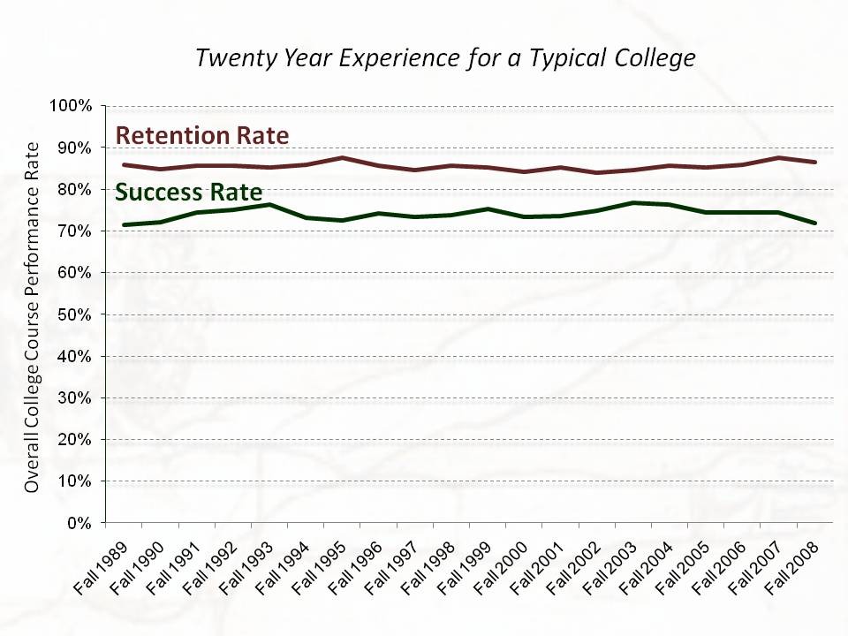
What are the two measures most widely used by CCCs to assess progress?
Consider the multitude of changes over this period:
- faculty/staff turnover
program successes/failures
changing student demographics
budget contractions/expansion
leadership turnover
and yet these performance metrics remained relatively stable.
Success Rate
Retention Rate

Slide 24
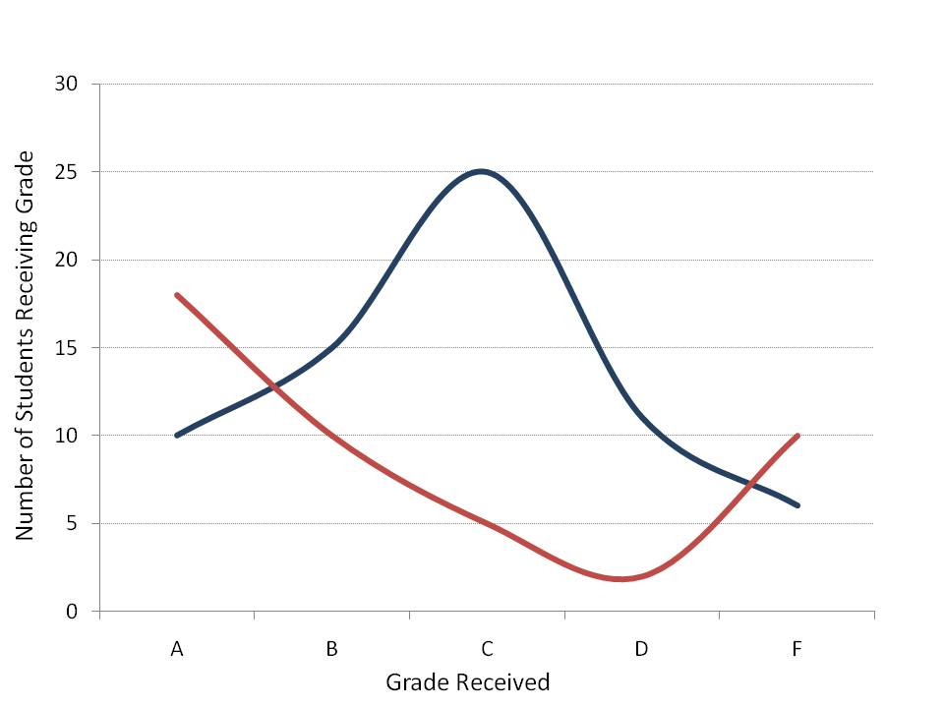
Looking solely at success rates can mask important features of student performance.
Evidence from a course on Writing Development (ENGL 836)
Fall 2008
Fall 2009
How similar are the learning environments of these two classrooms?
Success Rate: 74%
Research tells us that the English sequence completion rate for this group is likely to be much higher.
Success Rate: 73%
Success Rate = (A,B,C)/(A,B,C,D,F)

Slide 25
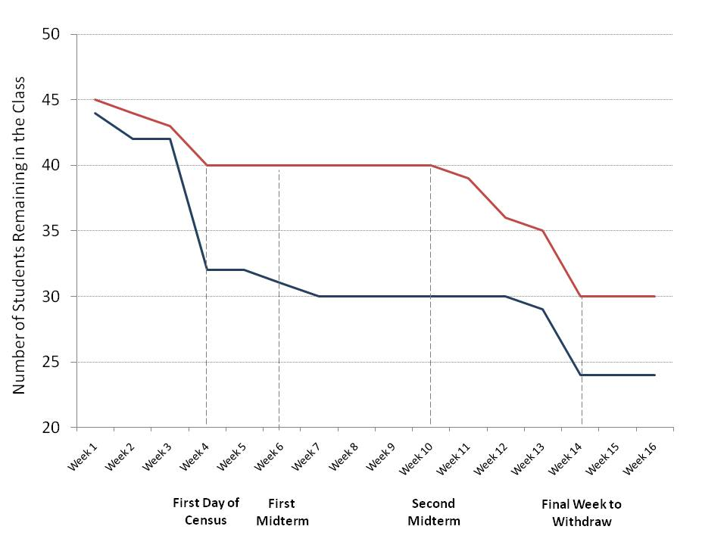
Likewise, two courses with identical retention rates can be very different classrooms and foreshadow different futures for students.
Evidence from a course on Intermediate Algebra (MATH 110)
Fall 2008
Spring 2009
Research tells us that those withdrawing from this class are more likely to pass a retake of the course.
Retention Rate: 75%
There are ten fewer students in the classroom during the period between the two midterms
Retention Rate: 75%
Retention Rate = (A,B,C,D,F) / (A,B,C,D,F,W)

Slide 26
Okay, that’s a lot to digest
Lets Discuss

