Slide 1
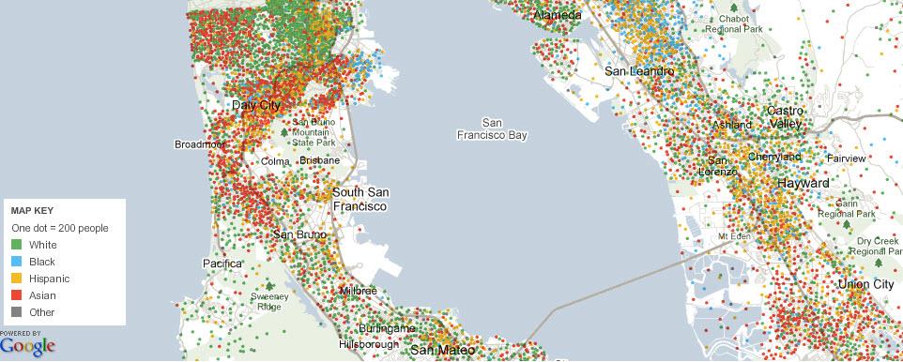
Distribution of Racial and Ethnicity Groups in the Northern Peninsula
Maps were taken from the New York Times online resource titled: Mapping America: Every City, Every Block
(link: http://projects.nytimes.com/census/2010/explorer?ref=us).
Map source data come from the Census Bureau's American Community Survey, based on samples from 2005 to 2009. Because these figures are based on samples, they are subject to a margin of error, particularly in places with a low population, and are best regarded as estimates.

Slide 2
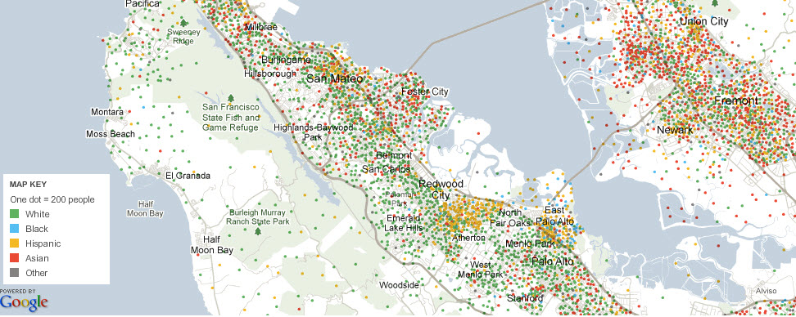
Distribution of Racial and Ethnicity Groups in the Southern Peninsula
Maps were taken from the New York Times online resource titled: Mapping America: Every City, Every Block
(link: http://projects.nytimes.com/census/2010/explorer?ref=us).
Map source data come from the Census Bureau's American Community Survey, based on samples from 2005 to 2009. Because these figures are based on samples, they are subject to a margin of error, particularly in places with a low population, and are best regarded as estimates.

Slide 3
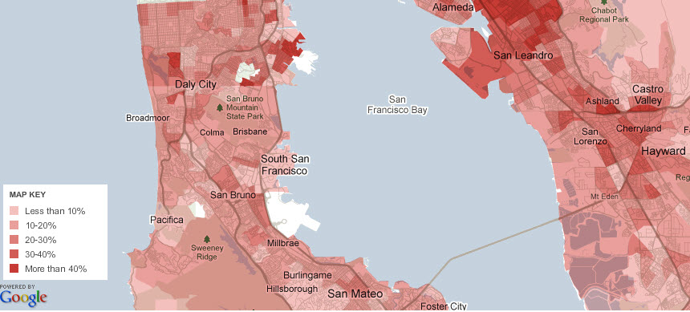
Distribution of Households Earning Under $30K in the Northern Peninsula
Maps were taken from the New York Times online resource titled: Mapping America: Every City, Every Block
(link: http://projects.nytimes.com/census/2010/explorer?ref=us).
Map source data come from the Census Bureau's American Community Survey, based on samples from 2005 to 2009. Because these figures are based on samples, they are subject to a margin of error, particularly in places with a low population, and are best regarded as estimates.

Slide 4
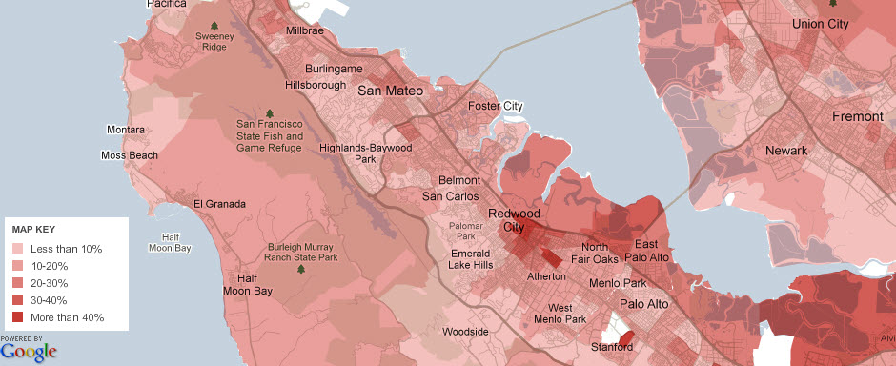
Distribution of Households Earning Under $30K in the Southern Peninsula
Maps were taken from the New York Times online resource titled: Mapping America: Every City, Every Block
(link: http://projects.nytimes.com/census/2010/explorer?ref=us).
Map source data come from the Census Bureau's American Community Survey, based on samples from 2005 to 2009. Because these figures are based on samples, they are subject to a margin of error, particularly in places with a low population, and are best regarded as estimates.

Slide 5
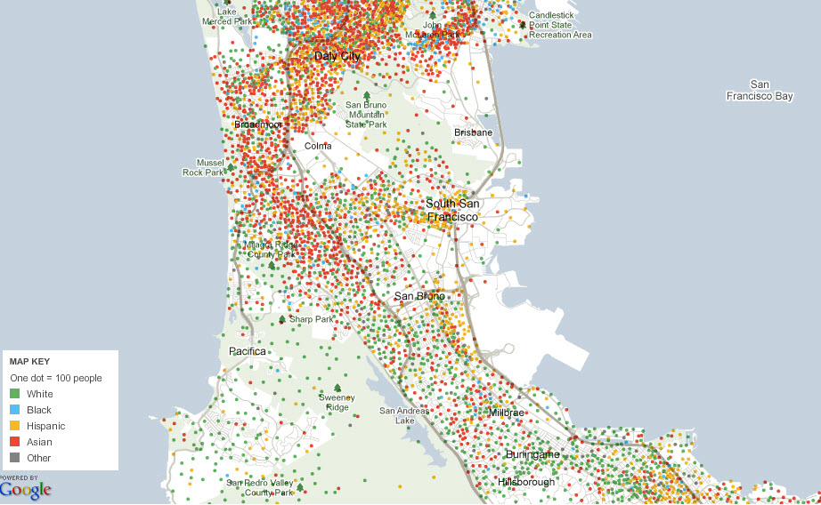
Distribution of Racial and Ethnicity Groups
Skyline
Maps were taken from the New York Times online resource titled: Mapping America: Every City, Every Block
(link: http://projects.nytimes.com/census/2010/explorer?ref=us).
Map source data come from the Census Bureau's American Community Survey, based on samples from 2005 to 2009. Because these figures are based on samples, they are subject to a margin of error, particularly in places with a low population, and are best regarded as estimates.

Slide 6
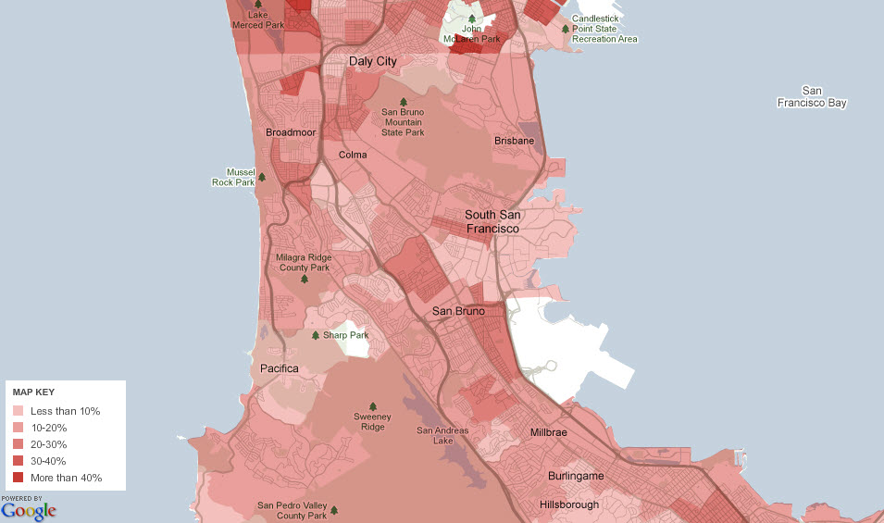
Distribution of Households Earning Under $30K
Skyline
Maps were taken from the New York Times online resource titled: Mapping America: Every City, Every Block
(link: http://projects.nytimes.com/census/2010/explorer?ref=us).
Map source data come from the Census Bureau's American Community Survey, based on samples from 2005 to 2009. Because these figures are based on samples, they are subject to a margin of error, particularly in places with a low population, and are best regarded as estimates.

Slide 7
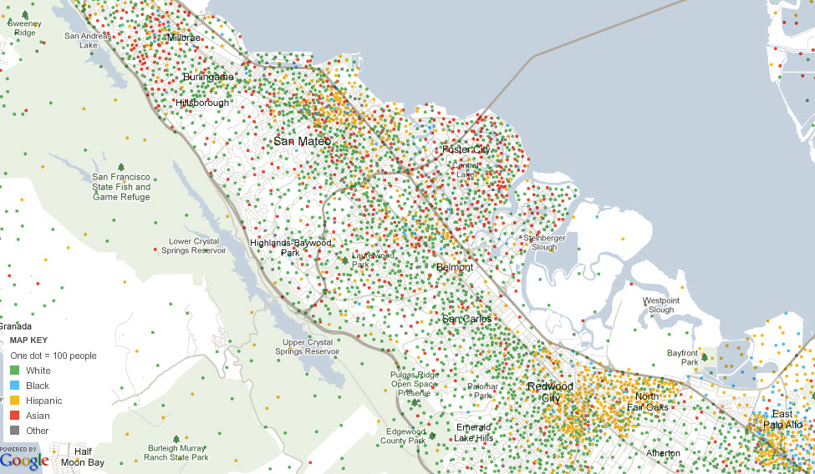
Distribution of Racial and Ethnicity Groups
CSM
Maps were taken from the New York Times online resource titled: Mapping America: Every City, Every Block
(link: http://projects.nytimes.com/census/2010/explorer?ref=us).
Map source data come from the Census Bureau's American Community Survey, based on samples from 2005 to 2009. Because these figures are based on samples, they are subject to a margin of error, particularly in places with a low population, and are best regarded as estimates.

Slide 8
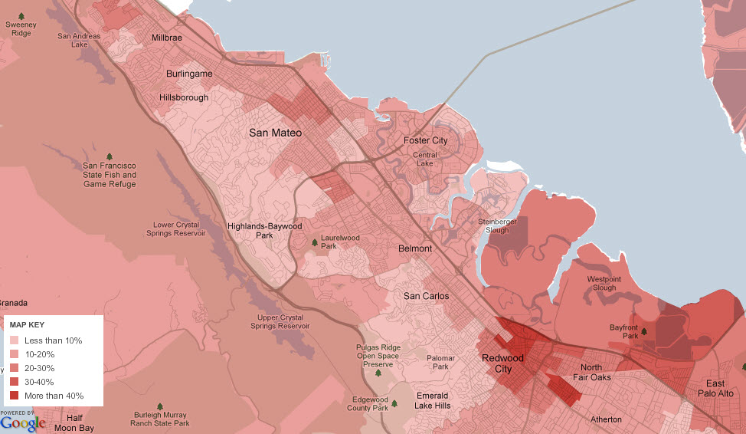
Distribution of Households Earning Under $30K
CSM
Maps were taken from the New York Times online resource titled: Mapping America: Every City, Every Block
(link: http://projects.nytimes.com/census/2010/explorer?ref=us).
Map source data come from the Census Bureau's American Community Survey, based on samples from 2005 to 2009. Because these figures are based on samples, they are subject to a margin of error, particularly in places with a low population, and are best regarded as estimates.

Slide 9
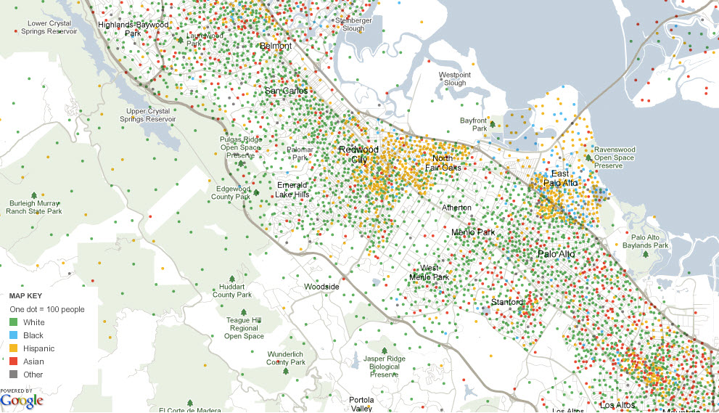
Distribution of Racial and Ethnicity Groups
Cañada
Maps were taken from the New York Times online resource titled: Mapping America: Every City, Every Block
(link: http://projects.nytimes.com/census/2010/explorer?ref=us).
Map source data come from the Census Bureau's American Community Survey, based on samples from 2005 to 2009. Because these figures are based on samples, they are subject to a margin of error, particularly in places with a low population, and are best regarded as estimates.

Slide 10
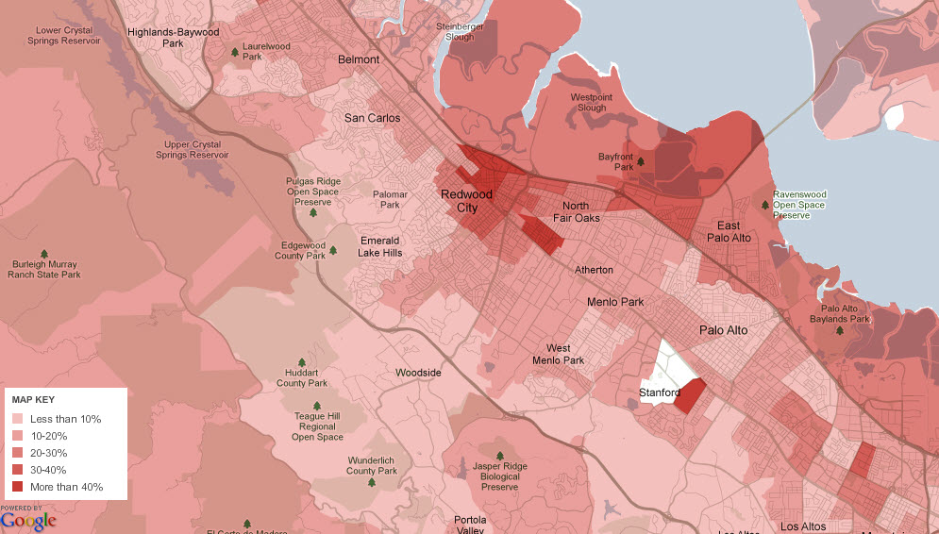
Distribution of Households Earning Under $30K
Cañada
Maps were taken from the New York Times online resource titled: Mapping America: Every City, Every Block
(link: http://projects.nytimes.com/census/2010/explorer?ref=us).
Map source data come from the Census Bureau's American Community Survey, based on samples from 2005 to 2009. Because these figures are based on samples, they are subject to a margin of error, particularly in places with a low population, and are best regarded as estimates.

