Slide 1
Local Business Needs Assessment
A Partnership between
The San Mateo County Community College District,
The San Mateo County Workforce Investment Board
&
The San Mateo County Economic Development Association
Gregory M Stoup
Director of Planning & Research
San Mateo County Community College District
Cañada College

Slide 2
Analysis of EMSI Labor Market Data
Occupational employment projections for San Mateo County for the period 2012 – 2017
Hierarchical occupational framework (Federal SOC Codes; N = 1,421)
      23 occupations at level 1 (Major Groups)
      97 occupations at level 2 (Minor Groups)
      461 occupations at level 3 (Broad Occupations)
      840 occupations at level 4 (Detailed Occupations)
Example
SOC Code | Level | Occupational title
21-0000 | 1 | Community and social services occupations
21-1000 | 2 | Counselors, social workers, and other social service specialists
21-1010 | 3 | Counselors
21-1011 | 4 | Substance abuse and behavioral disorder counselors
Dataset includes current employment levels, projected openings due to growth, retirements and turnover, median hourly wages and the education level associated with each detailed occupation

Slide 3
A quick
look at the biggest and fastest growing Major Occupations

Slide 4
Level 1 occupations with the highest levels of employment (2012)
Rank | Occupation Title | Currently Employed | Pct of County
1 | Sales and related occupations | 63,562 | 14%
2 | Office and administrative support occupations | 57,011 | 10%
3 | Management occupations | 44,507 | 9%
4 | Business and financial operations occupations | 38,441 | 9%
5 | Food preparation and serving related occupations | 28,911 | 8%
6 | Computer and mathematical science occupations | 26,029 | 7%
7 | Transportation and material moving occupations | 24,239 | 5%
8 | Arts, design, entertainment, sports, and media occupations | 20,652 | 5%
9 | Personal care and service occupations | 19,453 | 5%
10 | Building and grounds cleaning and maintenance occupations | 18,890 | 4%
-- | …All other occupations (N=13) | 18,488 | 23%
Level 1 occupations with the highest projected job openings (2017)
Rank | Occupation Title | Projected Openings | Pct of County
1 | Sales and related occupations | 11,601 | 14%
2 | Office and administrative support occupations | 7,786 | 12%
3 | Management occupations | 7,560 | 10%
4 | Business and financial operations occupations | 7,510 | 8%
5 | Food preparation and serving related occupations | 6,818 | 6%
6 | Computer and mathematical science occupations | 5,505 | 6%
7 | Transportation and material moving occupations | 3,999 | 5%
8 | Personal care and service occupations | 3,990 | 4%
9 | Arts, design, entertainment, sports, and media occupations | 3,972 | 4%
10 | Life, physical, and social science occupations | 3,179 | 4%
-- | …All other occupations (N=13) | 18,488 | 26%

Slide 5
What does this tell us?
Size matters; being big yields more job growth
Many of the largest and fastest growing occupations are at the entry level in the local service sector
Keep in mind
Employment growth in an occupation can come from two sources
  New Job Growth
  Job turnover

Slide 6
Industry Life Cycle
Occupational growth driven primarily by
New Jobs
Occupational growth driven primarily by Job Turnover
Occupational growth driven primarily by
New Jobs
Innovation
Industry Reinvented
Introduction
Decline
Growth
Maturity
New Growth
Growth
Industries that don’t reinvent themselves
Time

Slide 7
Local Projected Job Openings for all 23 Major Occupations in San Mateo County
Major Occupation Title | Projected 2017 Job Openings | Percent that are New Jobs | Percent from Turnover
Sales and related occupations | 11,601 | 28% | 72%
Office and administrative support occupations | 7,786 | 18% | 82%
Management occupations | 7,560 | 33% | 67%
Business and financial operations occupations | 7,510 | 54% | 46%
Food preparation and serving related occupations | 6,818 | 22% | 78%
Computer and mathematical science occupations | 5,505 | 62% | 38%
Transportation and material moving occupations | 3,999 | 19% | 81%
Personal care and service occupations | 3,990 | 39% | 61%
Arts, design, entertainment, sports, and media occupations | 3,972 | 40% | 60%
Life, physical, and social science occupations | 3,179 | 49% | 51%
Education, training, and library occupations | 2,615 | 37% | 63%
Healthcare practitioners and technical occupations | 2,504 | 36% | 64%
Building and grounds cleaning and maintenance occupations | 2,346 | 32% | 68%
Production occupations | 2,180 | 8% | 92%
Construction and extraction occupations | 1,984 | 18% | 82%
Installation, maintenance, and repair occupations | 1,799 | 24% | 76%
Architecture and engineering occupations | 1,160 | 31% | 69%
Healthcare support occupations | 1,152 | 54% | 46%
Protective service occupations | 1,045 | 20% | 80%
Community and social services occupations | 697 | 34% | 66%
Legal occupations | 652 | 39% | 61%
Farming, fishing, and forestry occupations | 201 | 19% | 81%
Military Occupations | 153 | 6% | 94%

Slide 8
Top five occupations with strongest growth in new jobs
Major Occupation Title | Projected 2017 Job Openings | Percent that are New Jobs | Percent from Turnover
Sales and related occupations | 11,601 | 28% | 72%
Office and administrative support occupations | 7,786 | 18% | 82%
Management occupations | 7,560 | 33% | 67%
Business and financial operations occupations | 7,510 | 54% | 46%
Food preparation and serving related occupations | 6,818 | 22% | 78%
Computer and mathematical science occupations | 5,505 | 62% | 38%
Transportation and material moving occupations | 3,999 | 19% | 81%
Personal care and service occupations | 3,990 | 39% | 61%
Arts, design, entertainment, sports, and media occupations | 3,972 | 40% | 60%
Life, physical, and social science occupations | 3,179 | 49% | 51%
Education, training, and library occupations | 2,615 | 37% | 63%
Healthcare practitioners and technical occupations | 2,504 | 36% | 64%
Building and grounds cleaning and maintenance occupations | 2,346 | 32% | 68%
Production occupations | 2,180 | 8% | 92%
Construction and extraction occupations | 1,984 | 18% | 82%
Installation, maintenance, and repair occupations | 1,799 | 24% | 76%
Architecture and engineering occupations | 1,160 | 31% | 69%
Healthcare support occupations | 1,152 | 54% | 46%
Protective service occupations | 1,045 | 20% | 80%
Community and social services occupations | 697 | 34% | 66%
Legal occupations | 652 | 39% | 61%
Farming, fishing, and forestry occupations | 201 | 19% | 81%
Military Occupations | 153 | 6% | 94%

Slide 9
Now let’s drill down to the more detailed occupational definitions and incorporate worker wage and skill level information

Slide 10
Level 4 occupations with the highest levels of employment (2012)
Rank | Occupation Title | Employed | Median Hourly Wage | Education Level
1 | Retail salespersons | 11,037 | $11.14 | Short-term on-the-job training
2 | Real estate sales agents | 10,244 | $8.49 | Postsecondary vocational award
3 | Managers, all other | 7,945 | $25.28 | Work experience in a related field
4 | Cashiers, except gaming | 7,765 | $10.93 | Short-term on-the-job training
5 | Management analysts | 7,391 | $31.11 | Degree plus work experience
6 | Personal financial advisors | 7,279 | $26.35 | Bachelor's degree
7 | General and operations managers | 6,598 | $57.30 | Degree plus work experience
8 | Janitors and cleaners | 6,236 | $12.06 | Short-term on-the-job training
9 | Office clerks, general | 6,137 | $15.00 | Short-term on-the-job training
10 | Executive secretaries & admin assistants | 5,874 | $25.06 | Work experience in a related field
Level 4 occupations with the highest projected job openings (2017)
Rank | Occupation Title | Projected Openings | Median Hourly Wage | Educational Level
1 | Retail salespersons | 1,913 | $11.14 | Short-term on-the-job training
2 | Real estate sales agents | 1,913 | $8.49 | Postsecondary vocational award
3 | Cashiers, except gaming | 1,870 | $10.93 | Short-term on-the-job training
4 | Waiters and waitresses | 1,779 | $9.13 | Short-term on-the-job training
5 | Managers, all other | 1,699 | $25.28 | Work experience in a related field
6 | Personal financial advisors | 1,671 | $26.35 | Bachelor's degree
7 | Management analysts | 1,612 | $31.11 | Degree plus work experience
8 | Securities, commodities, and sales agents | 1,560 | $28.32 | Bachelor's degree
9 | Computer software engineers, applications | 1,168 | $48.80 | Bachelor's degree
10 | Child care workers | 1,081 | $11.71 | Short-term on-the-job training

Slide 11
Level 4 Summary
Once again we see that growth is largely a function of size (the largest occs have the most openings)
Both top 10 lists have a mix of low skill/wage and high skill/wage jobs
Next Step
Can we use the education and skill level information to help us group the occupations into meaningful cohorts?

Slide 12
San Mateo employment and wage profile by worker education level
Worker Education Level | Total Current 2012 Employment | Percent of Total Current 2012 Employment | Total Projected 2017 Openings | Percent of Total Projected 2017 Openings | Current Median Hourly Wage
Short Term Training | 134,147 | 31% | 24,006 | 32% | $14.90
Moderate Training | 49,740 | 11% | 6,602 | 9% | $15.00
Long Term Training | 32,274 | 7% | 5,094 | 7% | $21.80
Related Work Exp | 54,315 | 12% | 8,316 | 11% | $21.90
Post Secondary Voc Awared | 29,712 | 7% | 4,795 | 6% | $21.64
AA Degree | 16,579 | 4% | 3,020 | 4% | $28.15
BA Degree | 93,313 | 21% | 18,608 | 25% | $31.92
Grad Degree | 25,984 | 6% | 4,625 | 6% | $36.51
Observation: there is something of a bimodal distribution on worker education level. The largest two segments are the Short Term Training and BA Degree workers. Note also that the BA worker capture over twice the hourly wage as the short term training worker.

Slide 13
Source of job openings for San Mateo by worker education level
Worker Education Level | Total Projected 2017 Openings | Percent that are New Jobs | Percent from Turnover
Short Term Training | 24,006 | 34% | 66%
Moderate Training | 6,602 | 5% | 95%
Long Term Training | 5,094 | 20% | 80%
Related Work Exp | 8,316 | 32% | 68%
Post Secondary Voc Awared | 4,795 | 5% | 95%
AA Degree | 3,020 | 40% | 60%
BA Degree | 18,608 | 33% | 67%
Grad Degree | 4,625 | 19% | 81%
Observation: jobs at both ends of the skills spectrum have strong new job growth

Slide 14
Now let’s take the education and skill level information available for the detailed occupational categories and apply it to the list of
Major Occupations

Slide 15
Education and skill requirements for top level occupations
 |  | Percent of Openings Requiring
Occupational Title | Projected 2017 Openings | On the Job Training | Work Experience | Vocational Award or AA Degree | BA or Grad Degree | Degree plus Work Experience
Management | 7,560 | 0% | 30% | 0% | 19% | 52%
Business and financial operations | 7,510 | 7% | 0% | 3% | 68% | 22%
Computer and mathematical science | 5,505 | 0% | 0% | 18% | 82% | 0%
Architecture and engineering | 1,160 | 1% | 0% | 14% | 85% | 0%
Life, physical, and social science | 3,179 | 0% | 0% | 8% | 92% | 0%
Community and social services | 697 | 10% | 0% | 0% | 90% | 0%
Legal | 652 | 13% | 0% | 13% | 73% | 1%
Education, training, and library | 2,615 | 13% | 6% | 11% | 69% | 1%
Arts, design, entertainment, sports, & media | 3,972 | 47% | 0% | 5% | 39% | 8%
Healthcare practitioners and technical | 2,504 | 4% | 0% | 61% | 35% | 0%
Healthcare support | 1,152 | 71% | 0% | 29% | 0% | 0%
Protective service | 1,045 | 88% | 11% | 0% | 0% | 0%
Food preparation and serving related | 6,818 | 97% | 3% | 0% | 0% | 0%
Building, grounds cleaning &maintenance | 2,346 | 84% | 16% | 0% | 0% | 0%
Personal care and service | 3,990 | 80% | 5% | 14% | 0% | 0%
Sales and related | 11,601 | 40% | 26% | 18% | 16% | 0%
Office and administrative support | 7,786 | 83% | 16% | 1% | 0% | 0%
Farming, fishing, and forestry | 201 | 81% | 16% | 0% | 0% | 0%
Construction and extraction | 1,984 | 87% | 12% | 0% | 0% | 0%
Installation, maintenance, and repair | 1,799 | 45% | 8% | 47% | 0% | 0%
Production | 2,180 | 90% | 4% | 5% | 0% | 0%
Transportation and material moving | 3,999 | 86% | 3% | 0% | 11% | 0%

Slide 16
Top five occupations being driven by new job growth
 |  | Percent of Openings Requiring
Occupational Title | Projected 2017 Openings | On the Job Training | Work Experience | Vocational Award or AA Degree | BA or Grad Degree | Degree plus Work Experience
Management | 7,560 | 0% | 30% | 0% | 19% | 52%
Business and financial operations | 7,510 | 7% | 0% | 3% | 68% | 22%
Computer and mathematical science | 5,505 | 0% | 0% | 18% | 82% | 0%
Architecture and engineering | 1,160 | 1% | 0% | 14% | 85% | 0%
Life, physical, and social science | 3,179 | 0% | 0% | 8% | 92% | 0%
Community and social services | 697 | 10% | 0% | 0% | 90% | 0%
Legal | 652 | 13% | 0% | 13% | 73% | 1%
Education, training, and library | 2,615 | 13% | 6% | 11% | 69% | 1%
Arts, design, entertainment, sports, & media | 3,972 | 47% | 0% | 5% | 39% | 8%
Healthcare practitioners and technical | 2,504 | 4% | 0% | 61% | 35% | 0%
Healthcare support | 1,152 | 71% | 0% | 29% | 0% | 0%
Protective service | 1,045 | 88% | 11% | 0% | 0% | 0%
Food preparation and serving related | 6,818 | 97% | 3% | 0% | 0% | 0%
Building, grounds cleaning &maintenance | 2,346 | 84% | 16% | 0% | 0% | 0%
Personal care and service | 3,990 | 80% | 5% | 14% | 0% | 0%
Sales and related | 11,601 | 40% | 26% | 18% | 16% | 0%
Office and administrative support | 7,786 | 83% | 16% | 1% | 0% | 0%
Farming, fishing, and forestry | 201 | 81% | 16% | 0% | 0% | 0%
Construction and extraction | 1,984 | 87% | 12% | 0% | 0% | 0%
Installation, maintenance, and repair | 1,799 | 45% | 8% | 47% | 0% | 0%
Production | 2,180 | 90% | 4% | 5% | 0% | 0%
Transportation and material moving | 3,999 | 86% | 3% | 0% | 11% | 0%

Slide 17
Top five occupations being driven by new job growth
Closely related occupations
 |  | Percent of Openings Requiring
Occupational Title | Projected 2017 Openings | On the Job Training | Work Experience | Vocational Award or AA Degree | BA or Grad Degree | Degree plus Work Experience
Management | 7,560 | 0% | 30% | 0% | 19% | 52%
Business and financial operations | 7,510 | 7% | 0% | 3% | 68% | 22%
Computer and mathematical science | 5,505 | 0% | 0% | 18% | 82% | 0%
Architecture and engineering | 1,160 | 1% | 0% | 14% | 85% | 0%
Life, physical, and social science | 3,179 | 0% | 0% | 8% | 92% | 0%
Community and social services | 697 | 10% | 0% | 0% | 90% | 0%
Legal | 652 | 13% | 0% | 13% | 73% | 1%
Education, training, and library | 2,615 | 13% | 6% | 11% | 69% | 1%
Arts, design, entertainment, sports, & media | 3,972 | 47% | 0% | 5% | 39% | 8%
Healthcare practitioners and technical | 2,504 | 4% | 0% | 61% | 35% | 0%
Healthcare support | 1,152 | 71% | 0% | 29% | 0% | 0%
Protective service | 1,045 | 88% | 11% | 0% | 0% | 0%
Food preparation and serving related | 6,818 | 97% | 3% | 0% | 0% | 0%
Building, grounds cleaning &maintenance | 2,346 | 84% | 16% | 0% | 0% | 0%
Personal care and service | 3,990 | 80% | 5% | 14% | 0% | 0%
Sales and related | 11,601 | 40% | 26% | 18% | 16% | 0%
Office and administrative support | 7,786 | 83% | 16% | 1% | 0% | 0%
Farming, fishing, and forestry | 201 | 81% | 16% | 0% | 0% | 0%
Construction and extraction | 1,984 | 87% | 12% | 0% | 0% | 0%
Installation, maintenance, and repair | 1,799 | 45% | 8% | 47% | 0% | 0%
Production | 2,180 | 90% | 4% | 5% | 0% | 0%
Transportation and material moving | 3,999 | 86% | 3% | 0% | 11% | 0%

Slide 18
Possible occupational segments
1. Life, physical & social science
2. Healthcare*
3. Business & Financial
The five segments collectively account for
128, 600 current jobs (28% of county)
25,000 projected job openings (32% of county)
12,500 projected opening from new growth (48 % of county)
Pay an average wage of roughly 20% above the county average (growth in this group raises county per capita income)
44 detail occupations
Current Jobs = 12,177
Projected Openings = 3,179
Most jobs require Post Secondary Degree/Certificate
61 detail occupations
Current Jobs = 24,269
Projected Openings = 3,656
Jobs are a mix of training and Post Secondary Degree/Certificate
30 detail occupations
Current Jobs = 38,441
Projected Openings = 7,510
Most jobs require Post Secondary Degree/Certificate
4. Art, design & new media
5. Computers Math & Engineering*
42 detail occupations
Current Jobs = 20,652
Projected Openings = 3,972
Jobs are a mix of training and Post Secondary Degree/Certificate
35 detail occupations
Current Jobs = 31,007
Projected Openings = 6,297
Most jobs require Post Secondary Degree/Certificate
* Segments made up of two major occupational groups. Healthcare is the combination of Healthcare practitioners & technical occupations (SIC 29) and Healthcare support occupations (SIC 31). Computers Math & Engineering is the aggregate of Computer, math & science occupations (SIC 15) and the engineering portion of SIC 17, Architecture & engineering occupations.

Slide 19
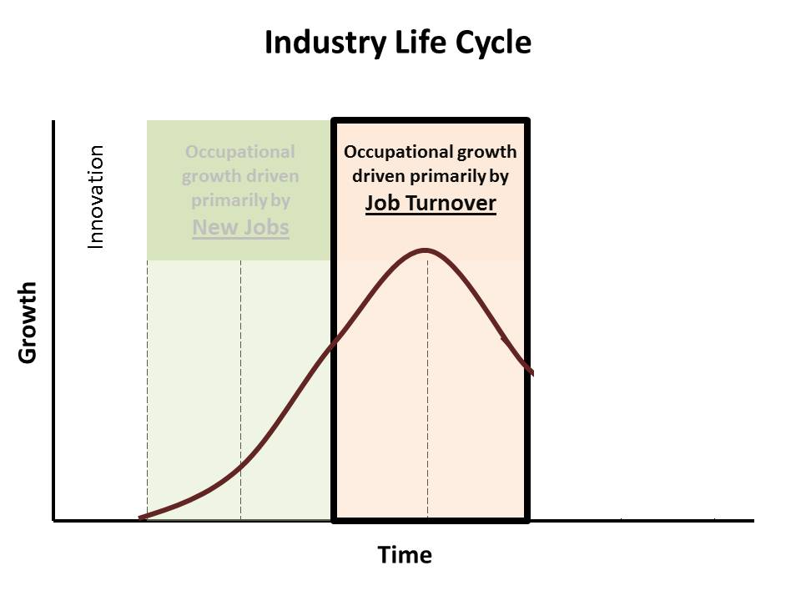
Are there any other occupational segments worthy of inclusion?
Should we consider any occupations where the growth is driven by turnover?
SIC 41: Sales & related occupations
    single largest employing sector (63,000)
    Transferable skills that accelerate career advancement
    Over two-thirds require post secondary education
    Real Estate related occupations make up the biggest segment of this group
SIC 49: Installation, maintenance & repair
    Large pct of openings from turnover
    Nearly 50% of jobs require voc ed or AA degree
    Fairly high median wage (short pathway to economic security)

Slide 20
Top five occupations being driven by new job growth
Closely related occupations
Other candidate occupations
 |  | Percent of Openings Requiring
Occupational Title | Projected 2017 Openings | On the Job Training | Work Experience | Vocational Award or AA Degree | BA or Grad Degree | Degree plus Work Experience
Management | 7,560 | 0% | 30% | 0% | 19% | 52%
Business and financial operations | 7,510 | 7% | 0% | 3% | 68% | 22%
Computer and mathematical science | 5,505 | 0% | 0% | 18% | 82% | 0%
Architecture and engineering* | 792 | 1% | 0% | 14% | 85% | 0%
Life, physical, and social science | 3,179 | 0% | 0% | 8% | 92% | 0%
Community and social services | 697 | 10% | 0% | 0% | 90% | 0%
Legal | 652 | 13% | 0% | 13% | 73% | 1%
Education, training, and library | 2,615 | 13% | 6% | 11% | 69% | 1%
Arts, design, entertainment, sports, & media | 3,972 | 47% | 0% | 5% | 39% | 8%
Healthcare practitioners and technical | 2,504 | 4% | 0% | 61% | 35% | 0%
Healthcare support | 1,152 | 71% | 0% | 29% | 0% | 0%
Protective service | 1,045 | 88% | 11% | 0% | 0% | 0%
Food preparation and serving related | 6,818 | 97% | 3% | 0% | 0% | 0%
Building, grounds cleaning &maintenance | 2,346 | 84% | 16% | 0% | 0% | 0%
Personal care and service | 3,990 | 80% | 5% | 14% | 0% | 0%
Sales and related | 11,601 | 40% | 26% | 18% | 16% | 0%
Office and administrative support | 7,786 | 83% | 16% | 1% | 0% | 0%
Farming, fishing, and forestry | 201 | 81% | 16% | 0% | 0% | 0%
Construction and extraction | 1,984 | 87% | 12% | 0% | 0% | 0%
Installation, maintenance, and repair | 1,799 | 45% | 8% | 47% | 0% | 0%
Production | 2,180 | 90% | 4% | 5% | 0% | 0%
Transportation and material moving | 3,999 | 86% | 3% | 0% | 11% | 0%
* Projected openings reflects the removal of the architectural occupations from the segment

Slide 21
Thoughts?

Slide 22
APPENDIX

Slide 23
A detailed listing of occupations within each Cluster
(Lists limited to occupations employing at least 100 workers in San Mateo County)

Slide 24
1. Life, physical & social science
Occupation Title | 2012 Employment
Medical scientists, except epidemiologists | 2,824
Market research analysts | 2,280
Clinical, counseling, and school psychologists | 1,138
Chemists | 822
Biochemists and biophysicists | 782
Biological technicians | 694
Chemical technicians | 508
Environmental scientists and specialists, including health | 287
Physicists | 268
Microbiologists | 259
Life, physical, and social science technicians, all other | 194
Physical scientists, all other | 190
Survey researchers | 181
Urban and regional planners | 170
Biological scientists, all other | 169
Life scientists, all other | 148
Psychologists, all other | 145
Environmental science and protection technicians, including health | 123
Geoscientists, except hydrologists and geographers | 109

Slide 25
2. Healthcare (part a)
Occupation Title | 2012 Employment
Registered nurses | 4,782
Physicians and surgeons | 2,214
Licensed practical and licensed vocational nurses | 1,139
Pharmacy technicians | 533
Dental hygienists | 487
Pharmacists | 444
Dentists, general | 443
Medical and clinical laboratory technicians | 441
Physical therapists | 376
Radiologic technologists and technicians | 340
Speech-language pathologists | 334
Health diagnosing and treating practitioners, | 312
Medical and clinical laboratory technologists | 278
Surgical technologists | 277
Veterinary technologists and technicians | 257
Therapists, all other | 255
Medical records and health information technicians | 244
Emergency medical technicians and paramedics | 232
Dietitians and nutritionists | 190
Chiropractors | 186
Occupational therapists | 172
Veterinarians | 163
Respiratory therapists | 148
Physician assistants | 135
Diagnostic medical sonographers | 115
Opticians, dispensing | 111
Practitioners & Technical Occupations

Slide 26
2. Healthcare (part b)
Occupation Titles | 2012 Employment
Nursing aides, orderlies, and attendants | 2,263
Home health aides | 1,555
Medical assistants | 1,403
Dental assistants | 1,114
Massage therapists | 603
Healthcare support workers, all other | 540
Medical transcriptionists | 421
Veterinary assistants and laboratory animal caretakers | 208
Pharmacy aides | 147
Medical equipment preparers | 125
Support Occupations

Slide 27
3. Business & Financial
Occupational Title | 2012 Employment
Management analysts | 7,391
Personal financial advisors | 7,279
Accountants and auditors | 5,593
Business operation specialists, all other | 4,599
Financial analysts | 2,885
Appraisers and assessors of real estate | 1,195
Financial specialists, all other | 967
Employment, recruitment, and placement specialists | 827
Purchasing agents, except wholesale, retail, and farm products | 799
Human resources, training, and labor relations specialists, all other | 770
Compliance officers, except agriculture, construction, health and safety | 757
Cost estimators | 597
Training and development specialists | 590
Loan officers | 509
Wholesale and retail buyers, except farm products | 501
Tax preparers | 496
Compensation, benefits, and job analysis specialists | 485
Claims adjusters, examiners, and investigators | 322
Meeting and convention planners | 317
Logisticians | 315
Credit analysts | 289
Budget analysts | 260
Agents and business managers of artists, performers, and athletes | 206
Insurance underwriters | 164
Financial examiners | 113

Slide 28
4. Art, design & new media
Occupation Title | 2012 Employment
Photographers | 4,533
Graphic designers | 1,794
Writers and authors | 1,442
Musicians and singers | 1,386
Multi-media artists and animators | 1,333
Public relations specialists | 1,312
Art directors | 886
Interpreters and translators | 864
Coaches and scouts | 816
Editors | 636
Merchandise displayers and window trimmers | 456
Producers and directors | 455
Entertainers and performers, sports and related workers, all other | 414
Technical writers | 376
Interior designers | 319
Music directors and composers | 293
Media and communication workers, all other | 284
Audio and video equipment technicians | 212
Reporters and correspondents | 211
Film and video editors | 204
Radio and television announcers | 202
Commercial and industrial designers | 196
Fine artists, including painters, sculptors, and illustrators | 187
Artists and related workers, all other | 157
Sound engineering technicians | 136
Fashion designers | 120
Camera operators, television, video, and motion picture | 111

Slide 29
5. Computers Math & Engineering
Occupation Title | 2012 Employment
Computer software engineers, applications | 5,741
Computer software engineers, systems software | 4,153
Computer systems analysts | 3,609
Network systems and data communications analysts | 2,498
Computer support specialists | 2,404
Computer specialists, all other | 1,984
Computer programmers | 1,983
Network and computer systems administrators | 1,901
Database administrators | 595
Computer and information scientists, research | 458
Operations research analysts | 354
Statisticians | 260
Computer & Math Cluster
Civil engineers | 699
Computer hardware engineers | 553
Industrial engineers | 553
Biomedical engineers | 476
Aerospace engineers | 428
Mechanical engineers | 388
Electrical engineers | 340
Electronics engineers, except computer | 338
Electrical and electronic engineering technicians | 305
Engineering technicians, except drafters, all other | 194
Industrial engineering technicians | 164
Electro-mechanical technicians | 132
Environmental engineers | 127
Mechanical engineering technicians | 107
Engineering Cluster*
* List does not include architecture occupations listed in Major Category (SIC 17)

Slide 30
Additional Material
Maneuvering from occupations to industries

Slide 31
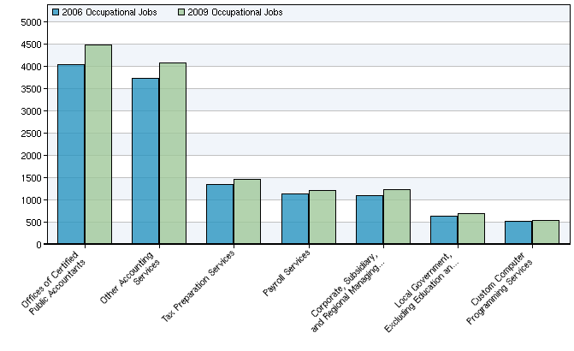
Industry employment profile for Accountants & Auditors
Industry Title | 2012 Jobs | 2017 Jobs | Change | % Change
Offices of Certified Public Accountants | 4,032 | 4,474 | 442 | 11%
Other Accounting Services | 3,722 | 4,069 | 347 | 9%
Tax Preparation Services | 1,353 | 1,469 | 116 | 9%
Payroll Services | 1,127 | 1,216 | 89 | 8%
Corporate, Subsidiary, and Regional Managing Offices | 1,104 | 1,238 | 134 | 12%
Local Government, Excluding Education and Hospitals | 639 | 695 | 56 | 9%
Custom Computer Programming Services | 513 | 547 | 34 | 7%

