Slide 1

Accountability Report for Community Colleges
AKA
THE ARCC REPORT
2012
Released annually by the Chancellor’s Office
Set of seven College Performance Indicators
Peer Group Benchmarks (CCCs)
The College must craft a brief self-assessment
Report is shared with Board of Trustees & the Public

Slide 2
ARCC’s Seven Indicators
Student Progress & Achievement
Completed 30 or More Units
Fall to Fall Persistence
Vocational Course Completion
Basic Skills Course Completion
ESL Course Improvement
Basic Skills Improvement
Note on Peer Groups: Peer Groups are determine by examining a set of institutional and program specific characteristics across the California Community College System. Peer groups are indicator specific, and therefore the list of colleges in the peer group changes for each indicator.

Slide 3
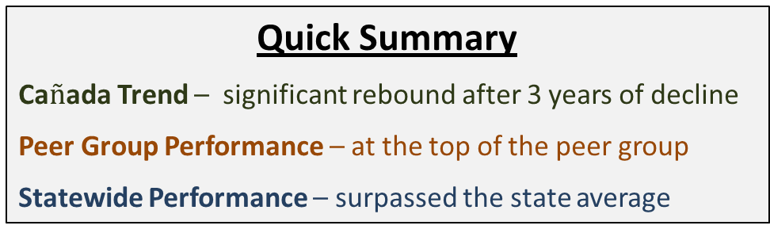
ARCC Table 1.1: Student Progress & Achievement Rate
Percentage of first-time students who showed intent to complete and who achieved any of the following outcomes within six years: Transferred to a four-year college; or earned an AA/AS; or earned a Certificate (18 units or more); or achieved "Transfer Directed“ or Transfer Prepared status
- Peer Group Range
- State average
Quick Summary
Ca$ñ$ada Trend – significant rebound after 3 years of decline
Peer Group Performance – at the top of the peer group
Statewide Performance – surpassed the state average
Peer Group for Indicator: Canada; Compton; L.A. City; L.A. Trade-Tech; Merced; Mission; Rio Hondo; Santa Ana; Southwest L.A.

Slide 4
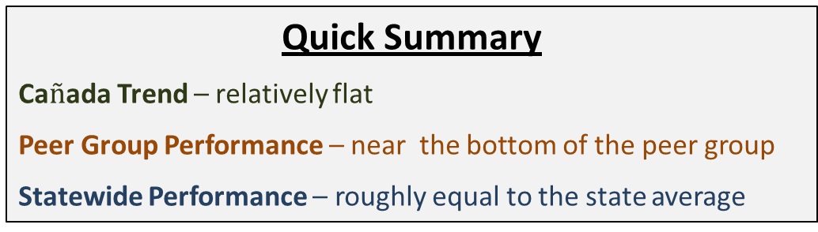
ARCC Table 1.1a: Percent of Students Earning 30+ Units
Percentage of first-time students who showed intent to complete and who earned at least 30 units while in the California Community College System.
- Peer Group Range
- State average
Quick Summary
Ca$ñ$ada Trend – relatively flat
Peer Group Performance – near the bottom of the peer group
Statewide Performance – roughly equal to the state average
Peer Group for Indicator: Canada; Foothill; Marin; San Mateo; West Valley.

Slide 5
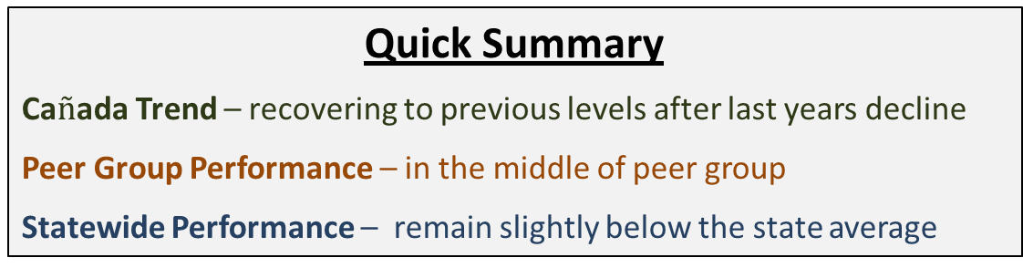
ARCC Table 1.2: Persistence Rate
Percentage of first-time students with a minimum of six units earned in a Fall term and who returned and enrolled in the subsequent Fall term anywhere in the system.
- Peer Group Range
- State average
Quick Summary
Ca$ñ$ada Trend – recovering to previous levels after last years decline
Peer Group Performance – in the middle of peer group
Statewide Performance – remain slightly below the state average
Peer Group for Indicator : Canada; Canyons; De Anza; Diablo Valley; Evergreen Valley; Foothill; Gavilan; Irvine Valley; Las Positas; Marin; Mission; Moorpark; Ohlone; Saddleback; San Jose City, San Mateo, West Valley

Slide 6
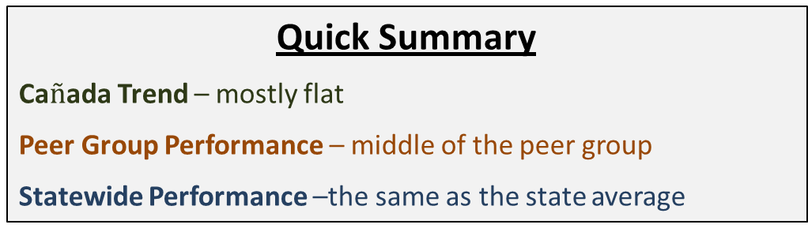
ARCC Table 1.3: Annual Successful Course Completion Rates (Vocational Courses)
- Peer Group Range
- State average
Quick Summary
Ca$ñ$ada Trend – mostly flat
Peer Group Performance – middle of the peer group
Statewide Performance –the same as the state average
Peer Group for Indicator: Allan Hancock, Barstow, Berkeley City College, Canada, Cerro Coso, Coastline, Columbia, Contra Costa, Cuyamaca, Feather River, Gavilan, Irvine Valley, L.A. City, Lake Tahoe, Laney, Marin, Mendocino, Merced, Merritt, Mission, Monterey, Napa Valley, Saddleback, Santa Rosa, Southwest L.A., West L.A., West Valley

Slide 7
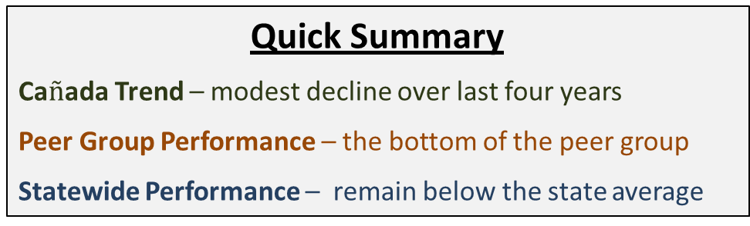
ARCC Table 1.4: Annual Successful Course Completion Rates (Credit Basic Skills Courses)
Success was defined as having been retained to the end of the term (or end of the course) with a final course grade of A, B, C, or P.
- Peer Group Range
- State average
Quick Summary
Ca$ñ$ada Trend – modest decline over last four years
Peer Group Performance – the bottom of the peer group
Statewide Performance – remain below the state average
Peer Group for Indicator: Allan Hancock, Cabrillo, Canada, Chabot,C itrus, Coastline, Contra Costa, Cosumnes River,Cuesta, Cuyamaca, Cypress, Evergreen Valley, Gavilan, Golden West, Grossmont, Hartnell,Irvine Valley, Las Positas, Los Medanos, Marin,Mira Costa, Mission, Monterey, Moorpark,Napa Valley, Ohlone, Oxnard, San Diego Miramar, San Jose City, San Mateo, Santiago Canyon, Shasta, Skyline, Solano, Ventura, West Valley

Slide 8
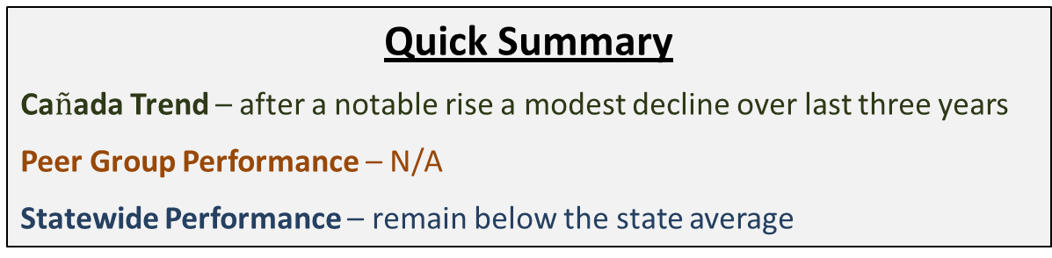
ARCC Table 1.5a: Improvement Rates for ESL
Students enrolled in a ESL course (two or more levels below college level/transfer level) who successfully completed the initial ESL course and then successfully completed a higher-level ESL course within three academic years.
- Peer Group Range
- State average
Quick Summary
Ca$ñ$ada Trend – after a notable rise a modest decline over last three years
Peer Group Performance – N/A
Statewide Performance – remain below the state average
Peer Group for Indicator: Canada, Cerro Coso, East L.A., Foothill, Hartnell, Irvine Valley, L.A. Trade-Tech, Marin, Mendocino, Mission, Monterey, Rio Hondo, San Mateo, Santa Rosa, Santiago Canyon, Skyline, West Valley

Slide 9
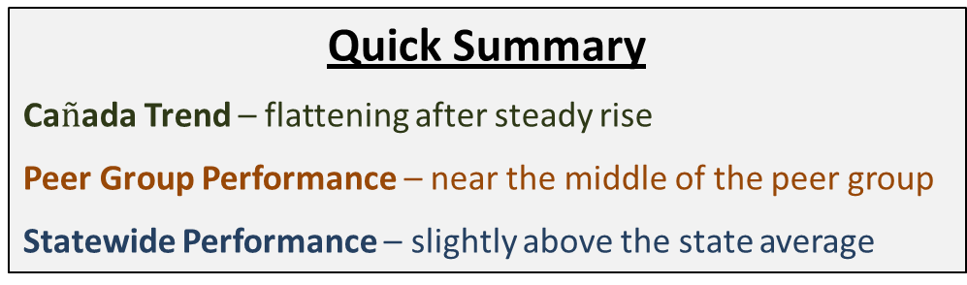
ARCC Table 1.5b: Improvement Rates for Credit Basic Skills
Students enrolled in a credit basic skills English or Mathematics course (two or more levels below college level/transfer level) who successfully completed the initial basic skills course and then successfully completed a higher-level course in the same discipline within three academic years.
- Peer Group Range
- State average
Quick Summary
Ca$ñ$ada Trend – flattening after steady rise
Peer Group Performance – near the middle of the peer group
Statewide Performance – slightly above the state average
Peer Group for Indicator: Allan Hancock, Barstow, Berkeley City College, Canada, Cerro Coso, Coastline, Columbia, Contra Costa, Cuyamaca, Feather River, Gavilan, Irvine Valley, Lake Tahoe, Laney, Lassen, Marin, Mendocino, Merritt, Mission, Monterey, Napa Valley, Palo Verde, Siskiyous, Taft, West Valley

Slide 10
ARCC Table of Values (2012)
ARCC Measure | Cañada College | Peer Group Low | Peer Group High | Statewide Average
Student Progress & Achievement | 54.8 | 25.0 | 54.8 | 53.6
Completed 30+ Units | 73.4 | 73.3 | 81.7 | 73.5
Persistence Rate | 68.4 | 62.7 | 83.4 | 71.3
Annual Successful Course Completion Rate (Vocational Courses) | 76.9 | 64.0 | 88.3 | 76.7
Annual Successful Course Completion Rate (Credit Basic Skills) | 52.3 | 52.3 | 72.6 | 62.0
Improvement Rate for ESL | 43.1 | 0 | 78.6 | 54.6
Improvement Rate for Basic Skills | 60.4 | 41.6 | 72.1 | 58.6

Slide 11
ARCC Table of Values (2011)
ARCC Measure | Cañada College | Peer Group Low | Peer Group High | Statewide Average
Student Progress & Achievement | 45.8 | 26.0 | 54.1 | 52.3
Completed 30+ Units | 73.1 | 69.7 | 77.8 | 72.4
Persistence Rate | 63.6 | 48.0 | 78.8 | 68.7
Annual Successful Course Completion Rate (Vocational Courses) | 77.0 | 63.6 | 87.3 | 77.5
Annual Successful Course Completion Rate (Credit Basic Skills) | 56.2 | 55.0 | 74.0 | 61.5
Improvement Rate for ESL | 46.8 | 0 | 67.0 | 50.1
Improvement Rate for Basic Skills | 56.2 | 55.0 | 74.0 | 61.5

Slide 12
ARCC Table of Values (2010)
ARCC Measure | Cañada College | Peer Group Low | Peer Group High | Statewide Average
Student Progress & Achievement | 48.5 | 25.7 | 52.6 | 51.8
Completed 30+ Units | 73.5 | 72.2 | 73.6 | 71.2
Persistence Rate | 68.9 | 63.0 | 78.1 | 69.2
Annual Successful Course Completion Rate (Vocational Courses) | 77.3 | 62.3 | 84.6 | 77.7
Annual Successful Course Completion Rate (Credit Basic Skills) | 56.1 | 52.0 | 72.0 | 60.5
Improvement Rate for ESL | 50.6 | 0 | 70.5 | 50.1
Improvement Rate for Basic Skills | 57.9 | 42.2 | 62.3 | 51.2

Slide 13
ARCC Table of Values (2009)
ARCC Measure | Cañada College | Peer Group Low | Peer Group High | Statewide Average
Student Progress & Achievement | 50.3 | 24.4 | 50.5 | 51.2
Completed 30+ Units | 71.4 | 71.2 | 75.0 | 70.4
Persistence Rate | 67.3 | 63.5 | 78.1 | 68.3
Annual Successful Course Completion Rate (Vocational Courses) | 78.1 | 65.8 | 86.8 | 78.2
Annual Successful Course Completion Rate (Credit Basic Skills) | 59.2 | 57.3 | 81.9 | 60.5
Improvement Rate for ESL | 44.5 | 14.4 | 67.3 | 50.0
Improvement Rate for Basic Skills | 53.9 | 44.6 | 62.4 | 44.7

